Slide 1

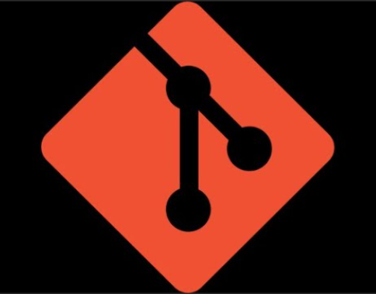

Git & Github
Ahmed Akram Amer

Slide 2



About Me
I am Student at Computer Science and Engineering Department at Faculty of Electronics Engineering (FEE).
I am interested in Machine Learning, Deep Learning, NLP and Computer Vision.
Contacts :
Linkedin www.linkedin.com/in/ahmed-akram-kamel-amer
Github https://github.com/Ahmed-7-ML
Kaggle Ahmed Akram Amer | Kaggle

Slide 3
Version Control System helps developers manage changes to source code or any collection of files over time. - Track every modification made to the codebase - Revert to previous versions when needed - Collaborate with multiple developers efficiently
Also called Source Control Manager
Track changes of the files and Control the Versions of the Projects.
Types
(LVC)
Local Version Control
(CVC)
Central Version Control
(DVC)
Distributed Version Control
Eng/ Ahmed Akram Amer

Slide 4
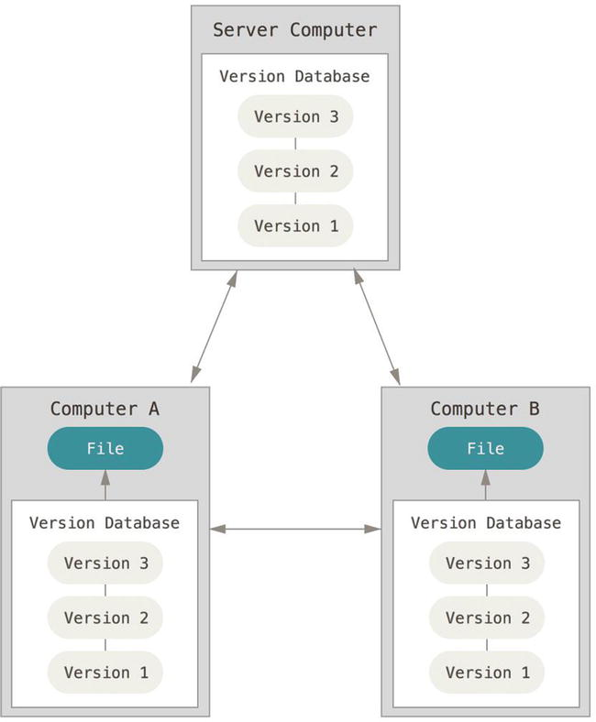
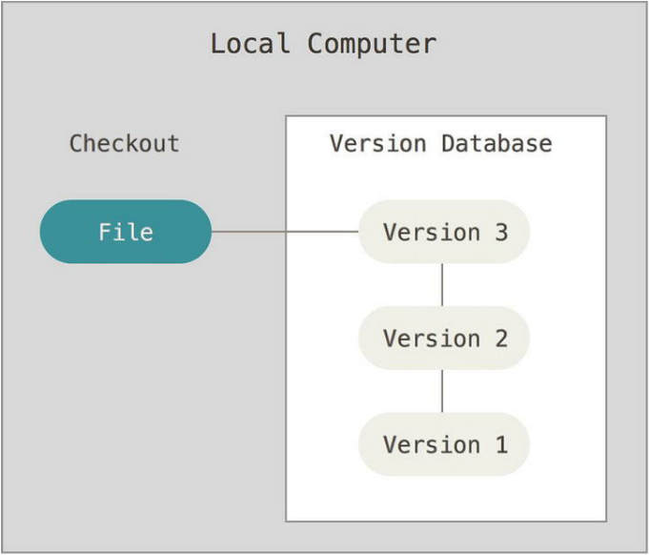
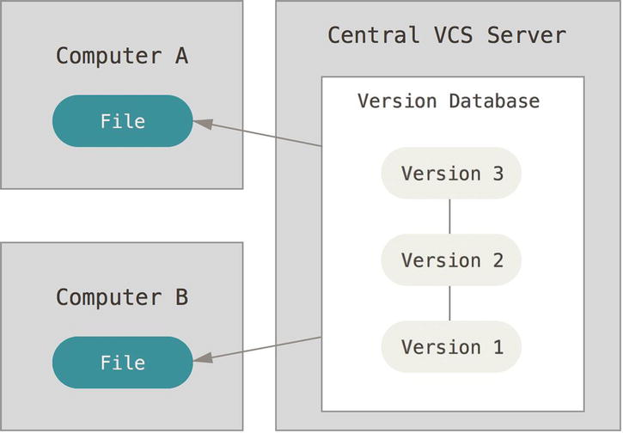
Type | Description
LVC (Local Version Control) | Tracks changes locally on your machine only.
CVC (Centralized VCS) | Uses a central server to store all versions (e.g., SVN).
DVC (Distributed VCS) | Each user has a complete copy of the repository (e.g., Git).
DVC
LVC
CVC

Slide 5
Why Git..?
Popular VCS – Git
Git is the most widely used version control system because it's:
Fast and efficient
Supports non-linear development (via branches)
Works offline (distributed model)

Slide 6

Git Sanpshots not Differences
Attributes :-
1- Simple Design
2- Speed
3- Support of Non-Linear Development
4- Distributed
5- Scalable

Slide 7
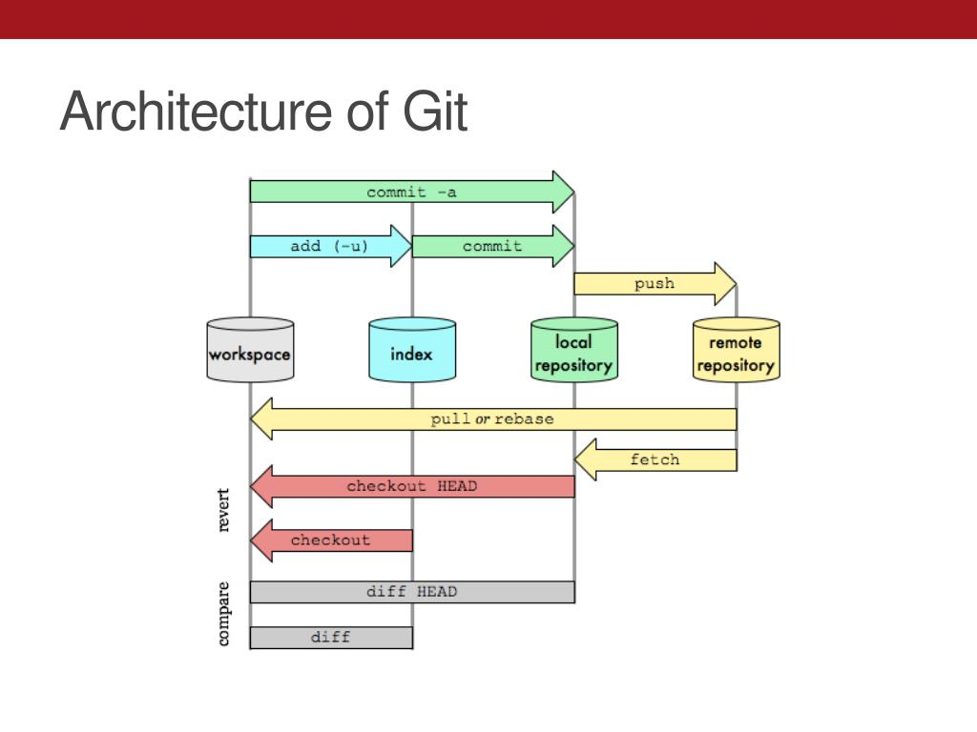
Git Architecture
Requirements:
1- Track everything (Content, Metadata)
2- OS-Independent (Portable) : Does not depend on a specific Operating System
3- Make a unique ID for each Object
4- Track the History of Changes
5- Track Objects without modifying them.
* Metadata : Contain Name of files, Size, Type, Permission,…

Slide 8
Git Objects
Binary Large Object
Object
Anything git tracks.
Types:
- Blob (File)
- Tree (Folder)
- Commit
- Tagged Annotation

Slide 9
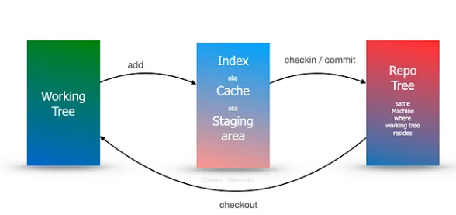
To make the git OS-Independent : Let Get Repository a simple folder structure and any content of this folder is just a simple file.
To make a unique identifier for each object : Use SHA-1 to use hash function.
To Track Changes : Compare this SHA-1 of the file to anthor.
Git has 3-Tree Architecture
Has 3 Folders :
Working Directory, Staging Area, Git Repository

Slide 10
3- Tree Architecture :
1 – Working Tree = Working Directory = Folder
2- Staging Area = Index : Physically File and Logically Tree
3- Git Repository (Repo)
Staging Area : It's like a chance to make sure of the changes before making the Commit (Troubleshooting) , Include what will be committed and Serve the Workflow.
- git add <file> : Convert File Status from Untracked (U) to Tracked.
- git commit –m “Message” : When confirming the modifications

Slide 11
Untracked: (Git does not care about it but will keep alerting you)
Unmodified (Either never changed since tracked, or commited and never changed afterwards)
Modified (Either doesn't have a snapshot or been changed since last commit)
Staged (Had some changes and ready to be committed)
File States
Untracked (U)
Tracked
Modified (M)
Unmodified

Slide 12
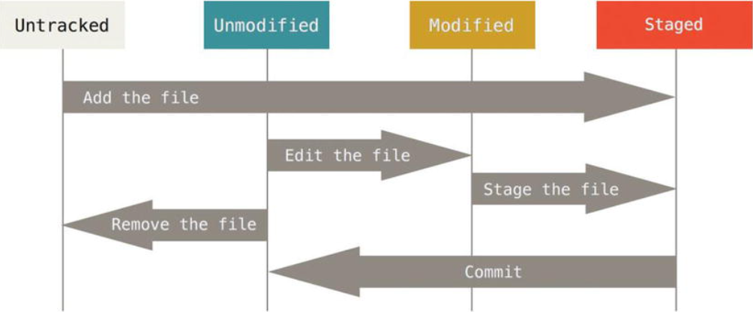

Slide 13
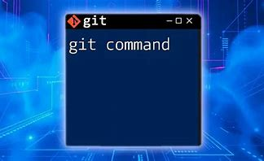
Git Commands

Slide 14
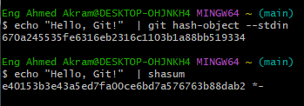
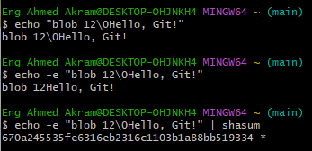
SHA – 1 = Unique 40 Hexadecimal Characters
Why it is different to the same input ?
Git add the Content, Type and Null (\0)

Slide 15
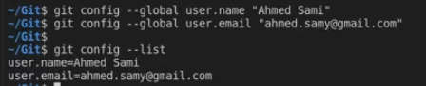
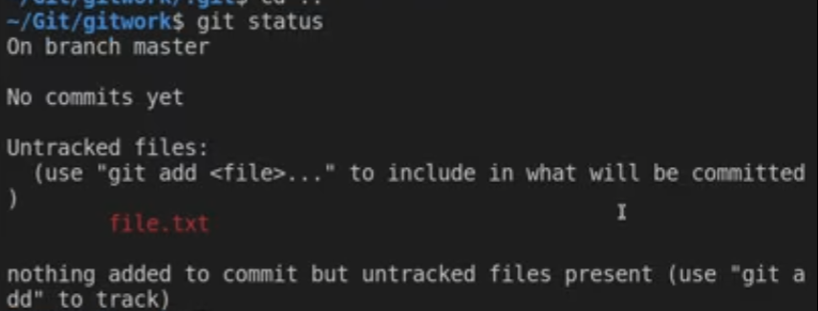
Commands
git config --global user.name “------” & git config --global user.email “-------” : Use these information to log who made the changes.
git init : Initialize a Git Repo. (Make a hidden folder [.git] inside the working directory)
Note : Initially all files are Untracked.
git status : Display the File State

Slide 16
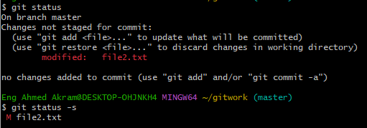
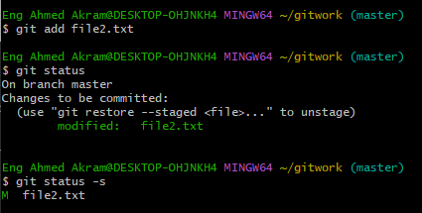
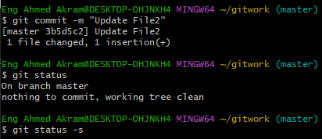
git status -s : Display the File State but in short.
Before Index Added
After Index Added
& Before Commit
After Commit

Slide 17
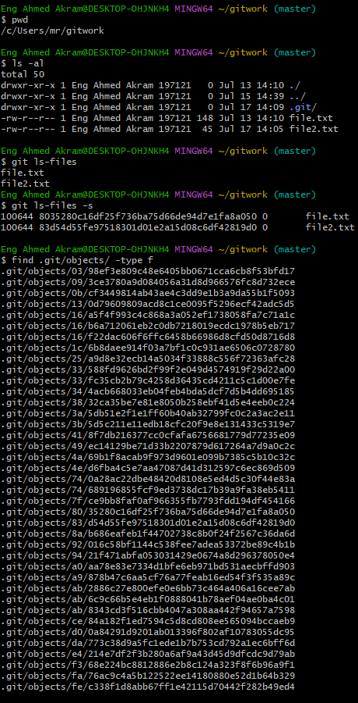
pwd : print the current working directory.
ls -al : Display Content in Working Directory
git ls-files : Display the Content in Staging Area(Index)
git ls-files -s : Display content with its SHA-1.
find .git/objects/ -type f : Display Content in Git Repo.

Slide 18
git add . : Add all files from working directory into Staging Area.
git add file.txt : Add the Specified file into Staging Area.
git add *.txt : U can use wild char to add files(e.g. add all files end with .txt).
git commit -m “Commit Message” : commit your staged content as a new commit snapshot .
git commit -am “Commit Message” : combine 2 steps together(git add & git commit -m).
git restore --staged <file> : Unstage the file (Remove from Index) and make it Untracked.
git restore <file> : Discard Changes in working directory.

Slide 19
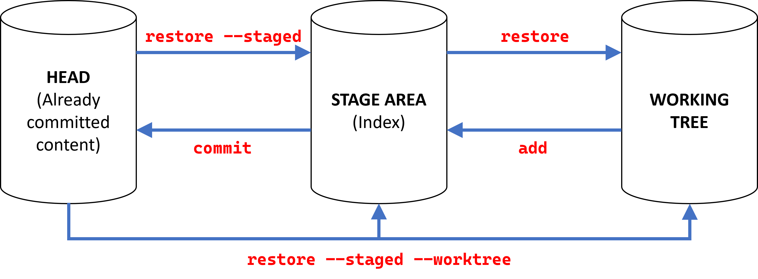

Slide 20
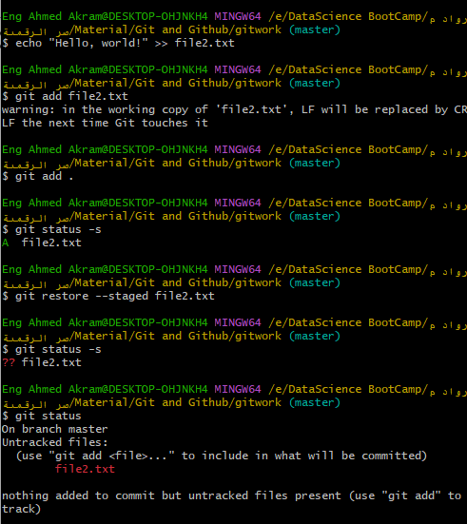
Add file to Staging Area (Index)
So the File State changed to A (Index Added)
Remove the file from Staging Area (Index)
So the File State changed to Red M (Untracked)

Slide 21
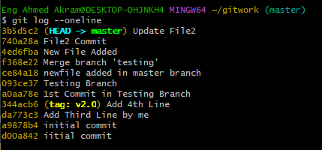
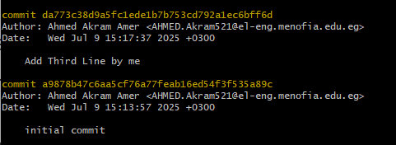
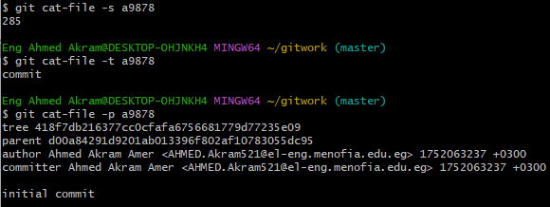
git log : Display a List of Commit Logs ordered from Oldest(Bottom) to Newest(Top) with details ( SHA-1 of a Commit, Author, Date and Commit Message)
git log --oneline : like git log but in short with only 7 hexadecimals of SHA-1 Commit and Commit Message.
git cat-file -p <SHA-1> : Show The Content of this SHA-1. of the Object.
git cat-file -t <SHA-1> : Show the Object Type.
git cat-file -s <SHA-1> : Show the Size.
4 hex for short

Slide 22
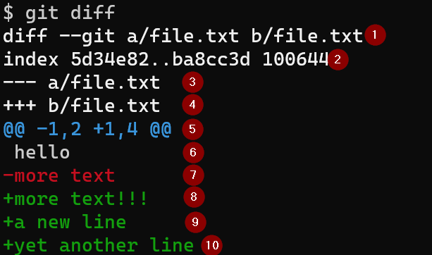
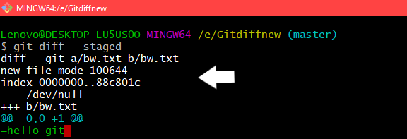
git diff : diff of what is changed but not staged (differ between working directory and Index).
Show the changes in your working directory that have not been staged yet.
git diff --staged : diff of what is staged but not yet committed (differ between Index and git repo)
Compare the Staging Area with Last Commit
Shows the changes that have been staged not yet committed.

Slide 23

Tags

Slide 24
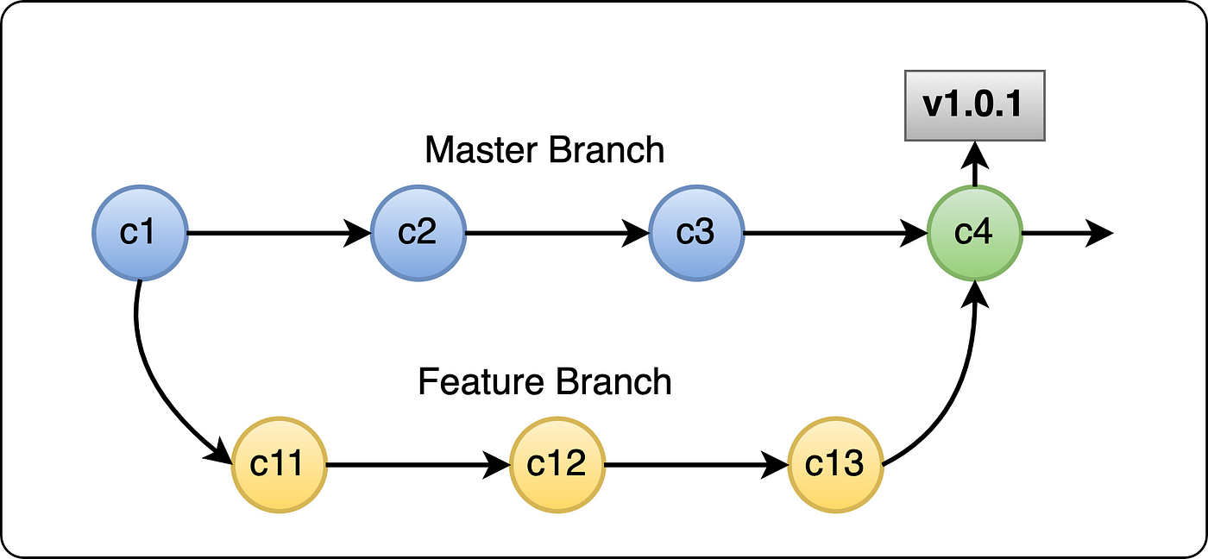
Git Tags: Used to mark specific points in history. Like a bookmark or labels on specific commits. Helpful in : - Versioning - Deployment - Rollback Types: 1) Lightweigthed Tag : Name/Label to point a commit git tag v1.0 2) Annotated Tag : Contain Extra Metadata like Tagger name, Date, Message and is stored as a full object in git history git tag -a v1.0 -m ‘Version 1.0 release’ git tag : Show all created tags git show v1.0 : To see a specific tag git tag –d v1.0 : Delete a tag

Slide 25
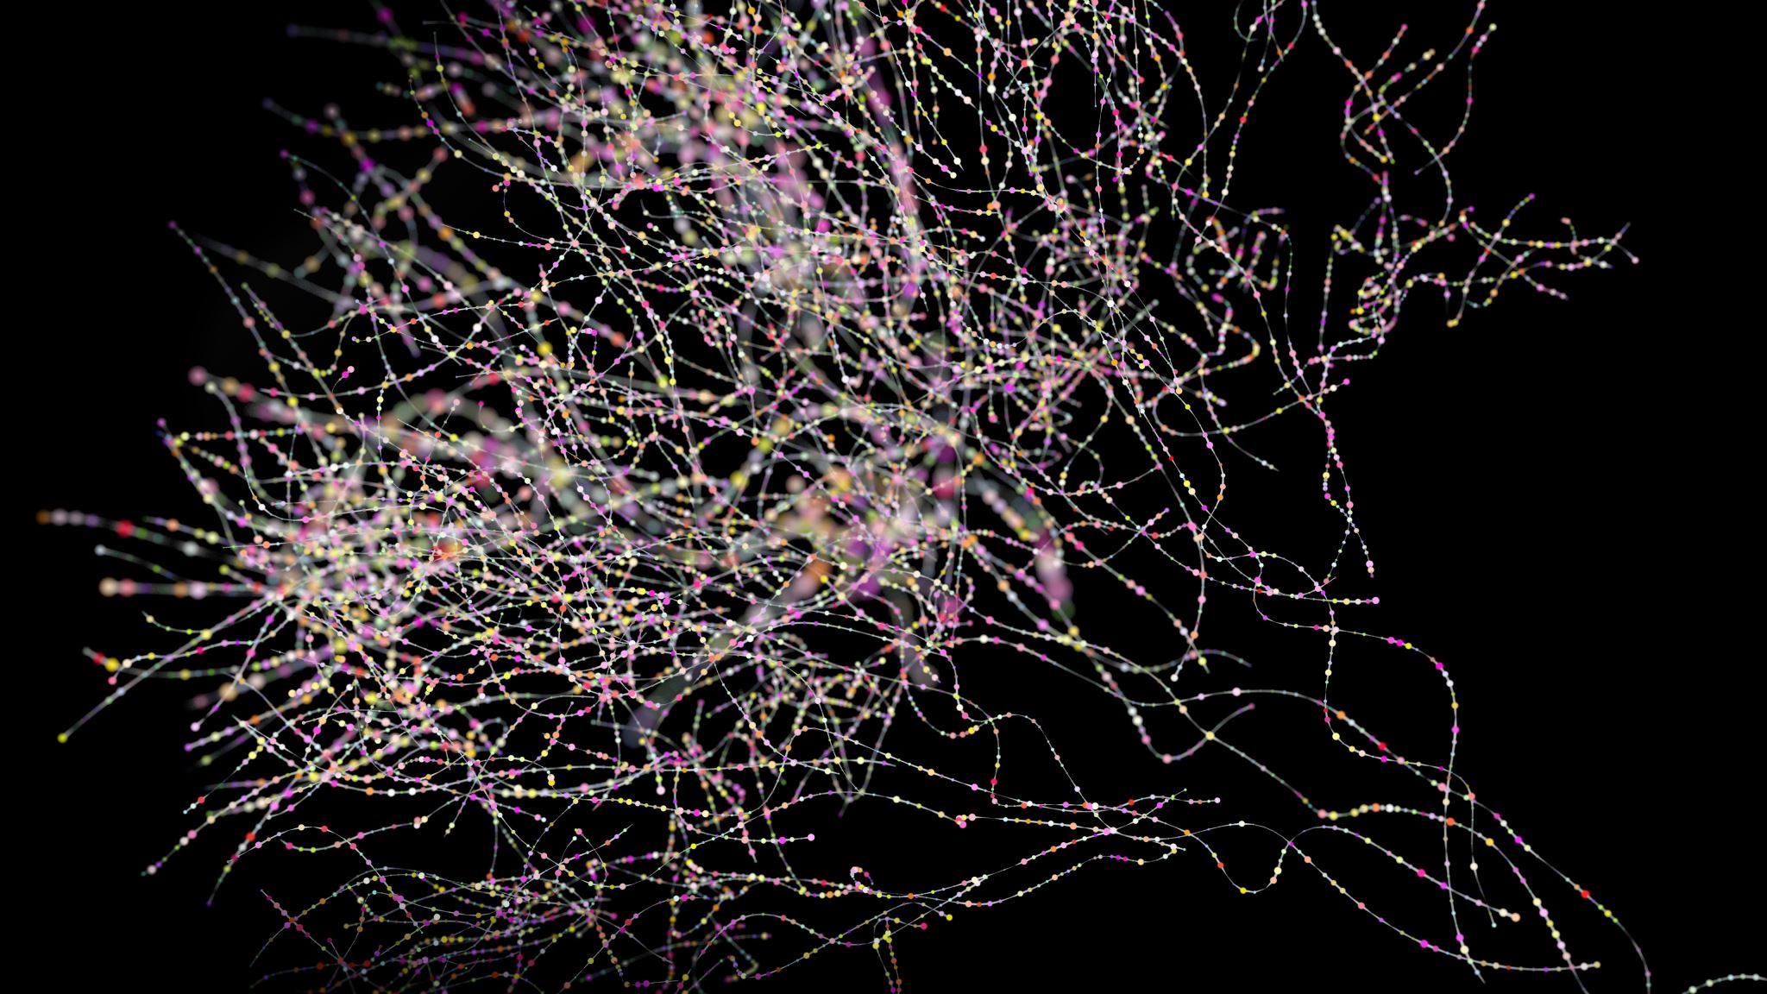
Branching

Slide 26
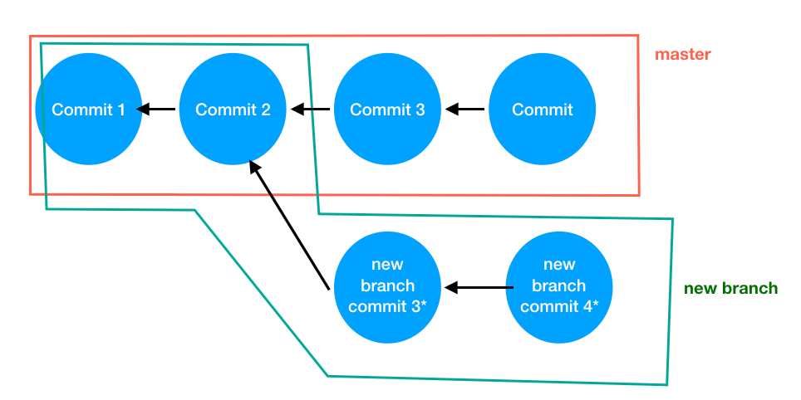
HEAD
Branching : Creating Independent Lines of Development, Work on a new features in isolation and collaborate without overwriting the other’s code.
The Default Branch : Master
Each Commit refers to the Parent of it -> Linear Branch Like a :inked List of Pointers
HEAD : refer to the last commit.

Slide 27
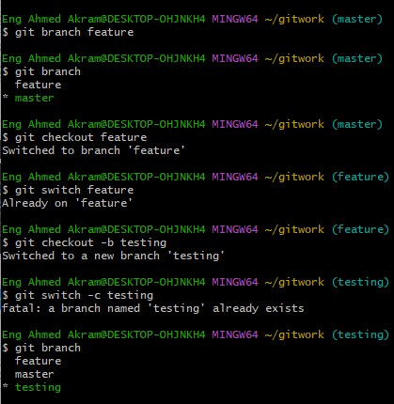
git branch: Display List all branches
git branch –a : Display all local & remote branches
git branch <name>: Create new branch.
git checkout <name>: Switch to a branch.
git switch <name>: also Switch to a new branch.
git checkout -b <name> :Create and switch in one command.
git switch –c <name>: Create and switch in one command.
* testing : means that this is current branch we work on

Slide 28
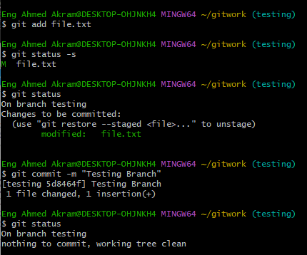
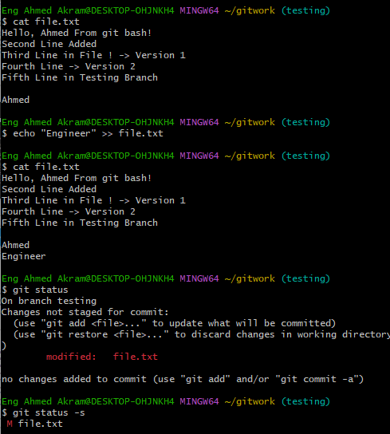
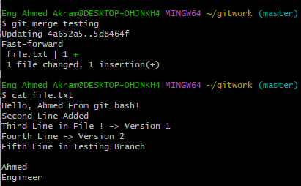
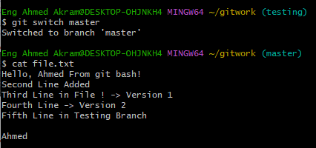
In testing branch , we made changes in file.txt
Commit the changes
So, we merge the 2 branches.
Switch to master check the same file
No Changes !

Slide 29
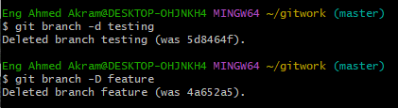
git switch master Then git merge <branch name> : Bring Changes from Source Branch to Destination Branch (master)
Destination : where you want to apply changes.
git branch -d <name>: Delete a branch (if merged).
git branch –D <name> : Force Delete if not merged.

Slide 30
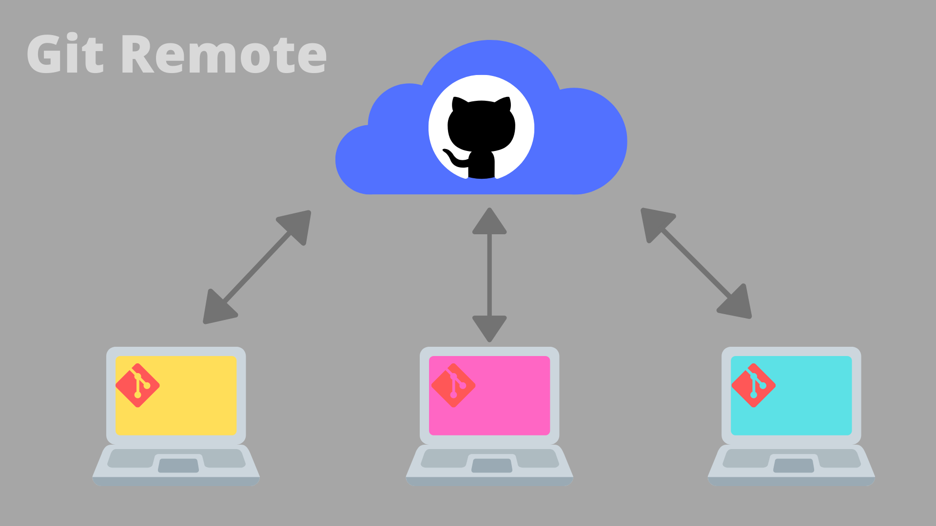
Remotes

Slide 31
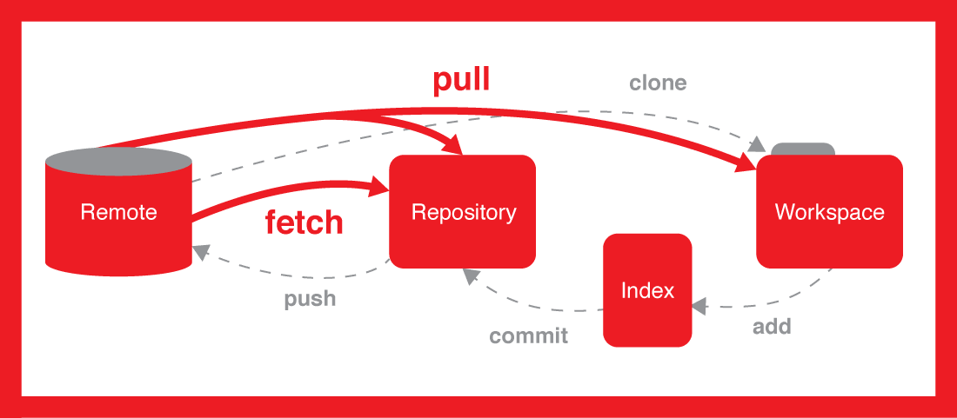
Remotes refer to versions of your project that are hosted elsewhere, typically on a remote server like GitHub, GitLab, or Bitbucket. They allow you to collaborate with others by pushing (Upstream) and pulling(Downstream) changes.
git remote : List all remotes associated with repo.
git remote -v: Show remotes
git remote add origin <url>: Add remote repo
git remote show origin: Details
git push -u origin main: Push & track
git remote remove origin : To remove a remote
git remote rename origin <name> :To rename a remote
git push origin main : Push Local changes to remote
git pull origin main: Pull latest changes from remote

Slide 32
Cloning
means creating a local copy of a remote Git repository.
It downloads:
All the project files
Full version history (commits, branches, tags)
The cloned folder becomes a fully working Git repository.
Repo copies on our local computer = local remotes
Use Case:
You want to contribute to an open-source project hosted on GitHub. You can clone it to your local machine, work on it, and then push your changes.
Remote repos are generally stored in an online hosting service e.g., GitHub, Bitbucket, or GitLab If we have an account: We can clone a remote repo on to our local computer git clone URL

Slide 33
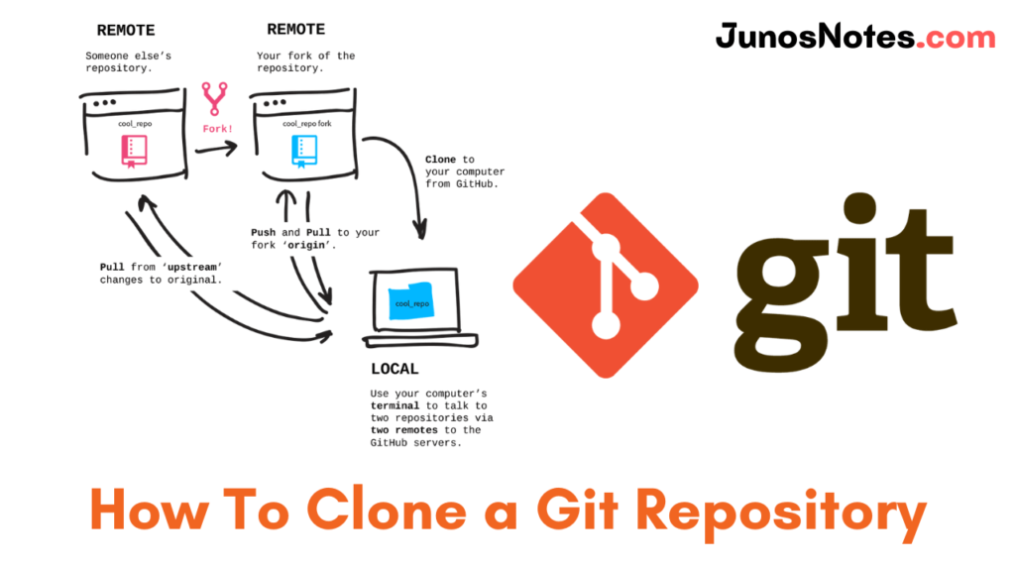
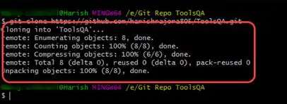
Making copies = cloning
git clone path-to-project-repo
Cloning a local project
git clone /home/george/repo
Cloning and naming a local project
git clone /home/george/repo <new_repo>

Slide 34
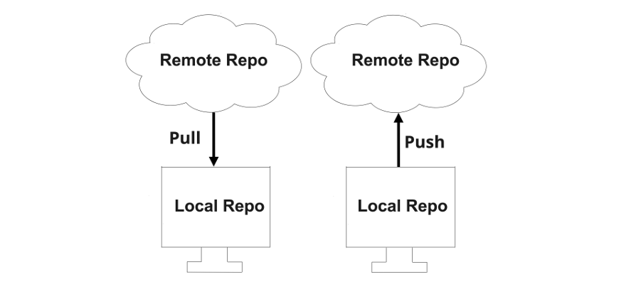
Pull & Push
1) Pull = Downstreaming
git pull origin <branch-name>
Downloads changes from a remote repository and merges them into your current local branch.
fetch changes from the remote then merge those changes into your current branch.
Get Updates from remote repo.
2) Push = Upstreaming
git push origin <branch-name>
Uploads your commits from your local branch to the remote repository.
Send Updates to remote repo.

Slide 35
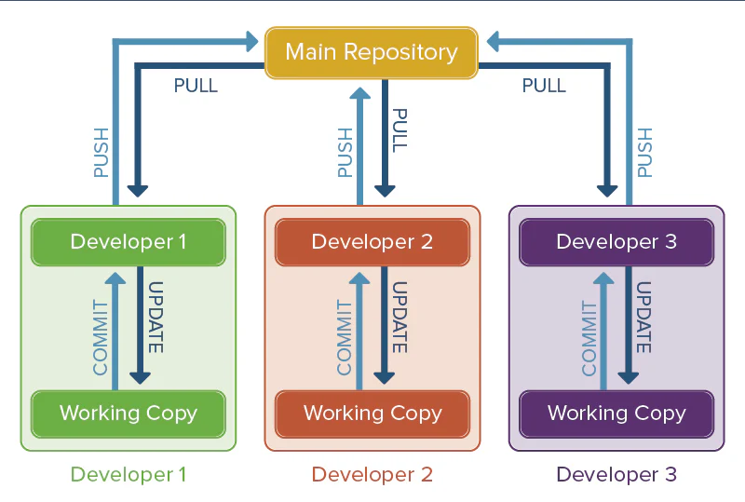

Slide 36

Conflicts

Slide 37
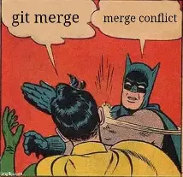
Conflicts
- Occur when 2 branches have competing changes and git can’t automatically decide which version to keep.
Happens when same line edited in branches.
If two branches modify the same lines of a file, Git will warn you of a conflict during merge. You need to resolve it manually.
Resolve steps:
1. Git marks the conflict
2. Manually edit
3. git add <file>
4. git commit
Example :
when 2 people edit the same line in the same file on different branches & when you try to merge those branches -> Conflict occurs.
For more : Visit https://www.w3schools.com/git/git_merge_conflicts.asp?remote=%7B%7BremoteName%7D%7D

Slide 38

Github

Slide 39
GitHub :
web-based platform that hosts Git repositories in the cloud. It allows developers to collaborate, share, and manage code easily.
Clone repo
Create branch
Commit & push
Create Pull Request (PR)
Review & Merge
Also: Issues, Stars, Forks

Slide 40
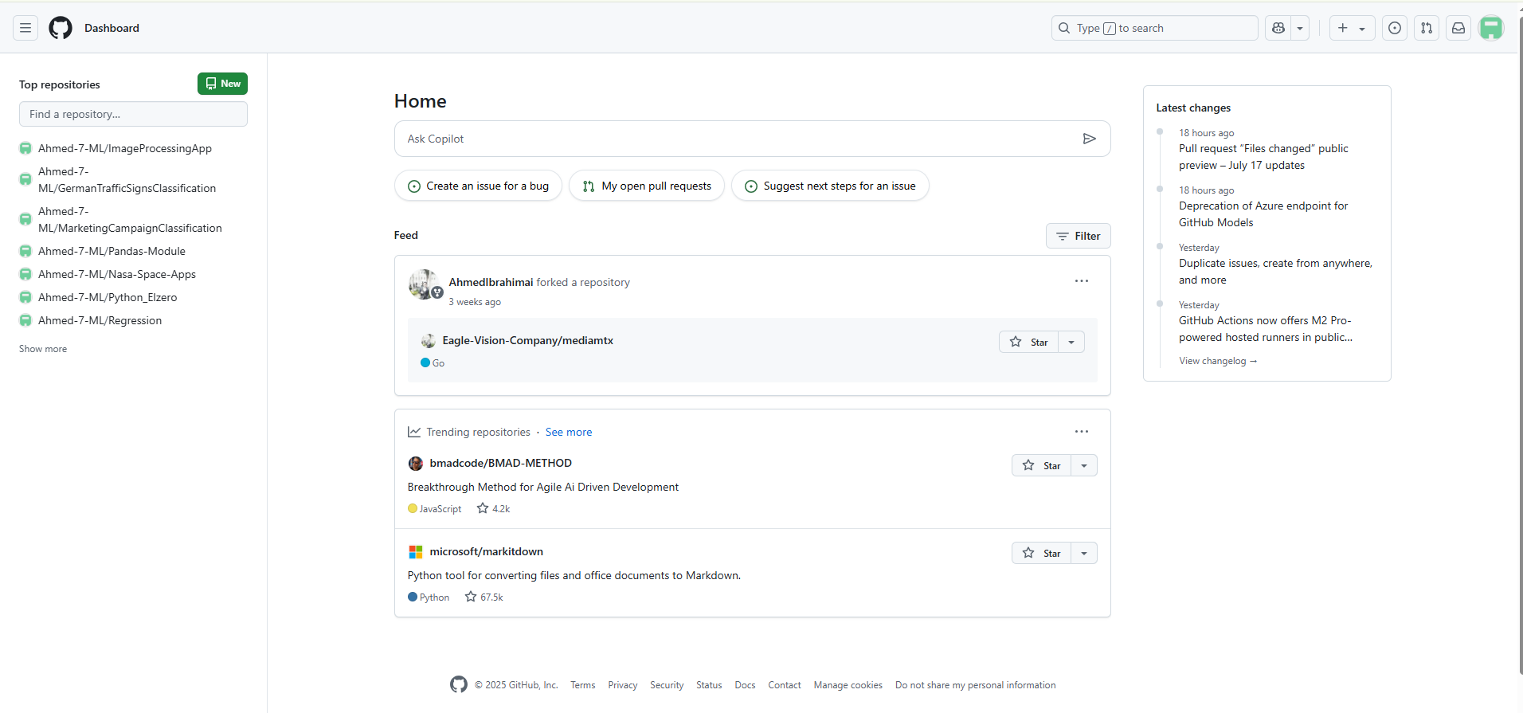

To Create a new Repo
Old created repos

Slide 41
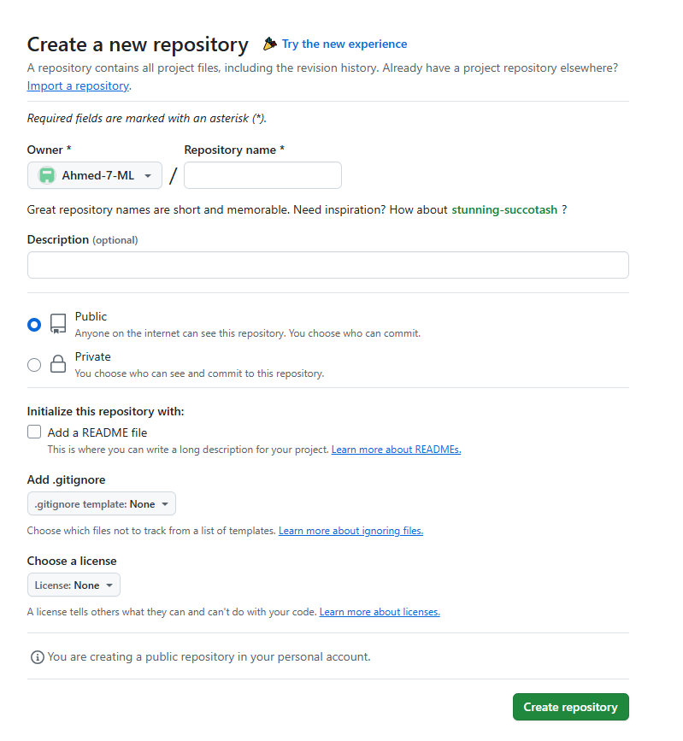
Owner of Repo.
Name of Repo.
You can add a description of your repo.
Public : Make anyone can see your repo.
Private: The owner of repo only or you may select some people to see it.
Add here the project description, how to use it& tools used
To make git ignore specific files

Slide 42
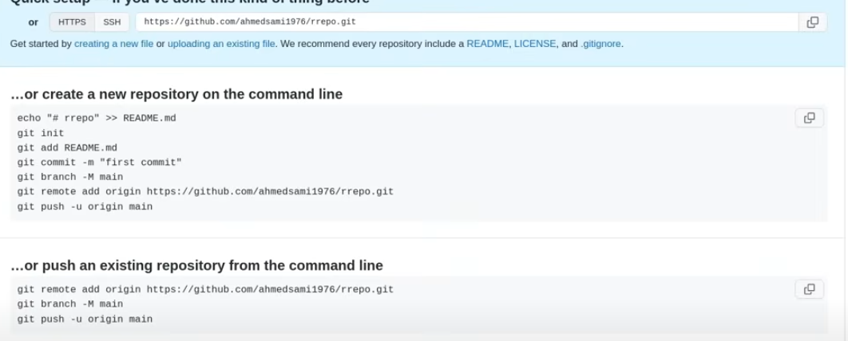
If you don’t add any files including the README, This commands to help you start sucessfully

Slide 43
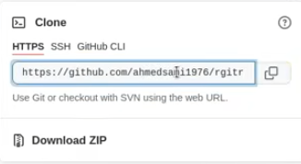
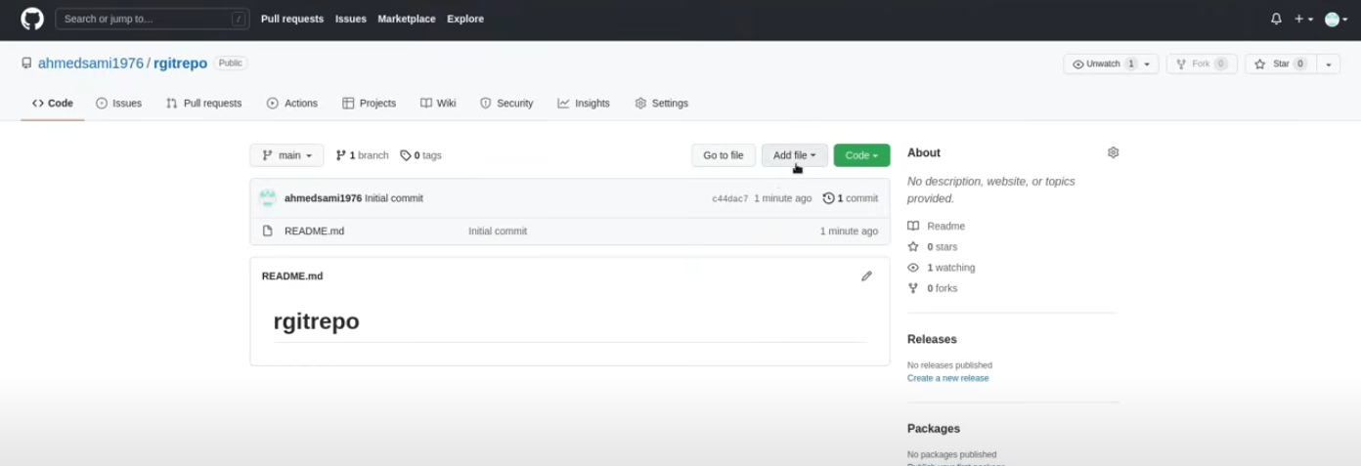
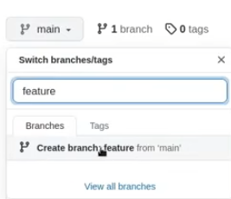
Sample
Clone then Push/Pull Or Download
Add new branches
Add new files from here
Or from git bash
You can edit here

Slide 44
Github Workflow
Fork : copy of a repository that lives under your GitHub account. It allows you to freely make changes to someone else’s project without affecting the original repo.
1. Fork the repository (if you don't have write access)
2. Clone your fork to your local machine:
git clone https://github.com/your-username/project.git
3. Create a new branch for your feature or fix:
git checkout -b feature-branch
4. Make your changes and commit them:
git add .
git commit -m "Add new feature"
5. Push your branch to GitHub:
git push origin feature-branch
6. Open a Pull Request on the original repo
7. Wait for review, discuss changes if needed
8. Once approved, the changes get merged
Fork
Clone
Merge
Branch
Pull Request
Commit

Slide 45

Resources
Eng. Ahmed Sami [Youtube]
https://youtu.be/Q6GJ54vgKc?si=fOPLU9Xrd9EzxlEl
Visual Git Reference
https://marklodato.github.io/visual-git-guide/index-en.html
W3Schools
Git Tutorial. Lessons for beginners. W3Schools in English
ChatGPT

Slide 46



Slide 47

Thank you

